Slide 1


Smart Inventory Management and Demand Prediction System
Capstone Project
Supervisor:
Dr. M Sathiyamoorthy
Department of Computer Science
SIMATS Engineering
Presented by:
G.Venkata Goutham Reddy (192324265)
D.Gunavardhan(192372041)
J.Goutham Kumar Reddy(192311140)
K.Raja Reddy (192372202)

Slide 2
Introduction
Retail and warehouse businesses handle thousands of products, and manual inventory tracking often leads to stockouts, overstocking, and lost revenue.
Demand for products fluctuates due to seasonality, trends, and promotions, making accurate forecasting difficult using traditional methods.
The Smart Inventory Management and Demand Prediction System is designed to automate stock tracking and forecast future demand using data analytics and machine learning.
The platform continuously monitors stock levels and predicts upcoming demand, helping businesses plan purchases and avoid shortages.
It provides automated alerts, reorder recommendations, and analytical dashboards to support faster, data-driven decisions.

Slide 3
Objectives
To develop a centralized platform for real-time tracking of stock levels across warehouses and stores.
To build a machine learning model that accurately predicts future product demand using historical sales data.
To implement automated low-stock alerts and intelligent reorder recommendations.
To provide a reporting dashboard for demand trends, sales analytics, and inventory turnover.
To enable store managers and suppliers to access accurate, real-time inventory information for better coordination.

Slide 4
Problem Statement
Existing System
Existing inventory tracking is largely manual, using spreadsheets or basic software that requires constant human updates.
Limited or no predictive intelligence is available to anticipate future product demand.
Inventory data and sales history are often scattered across disconnected systems, making analysis difficult.
Drawbacks of Existing System
Manual tracking increases the chances of human error and delayed updates.
Businesses frequently face stockouts, lost sales, or excess inventory due to inaccurate demand estimation.
Lack of real-time visibility leads to delayed decision-making and higher operational costs.

Slide 5
Proposed system
The proposed system is a Smart Inventory Management and Demand Prediction Platform that combines real-time inventory tracking with AI-driven demand forecasting.
It analyzes historical sales, seasonal trends, and market factors to accurately predict future product demand.
The system generates automated restocking alerts to minimize stockouts and reduce excess inventory.
Advantages
Reduces manual inventory management effort and human error.
Improves forecasting accuracy using machine learning models.
Enhances decision-making through real-time dashboards and analytics.
Minimizes stockouts, overstocking, and inventory holding costs.

Slide 6
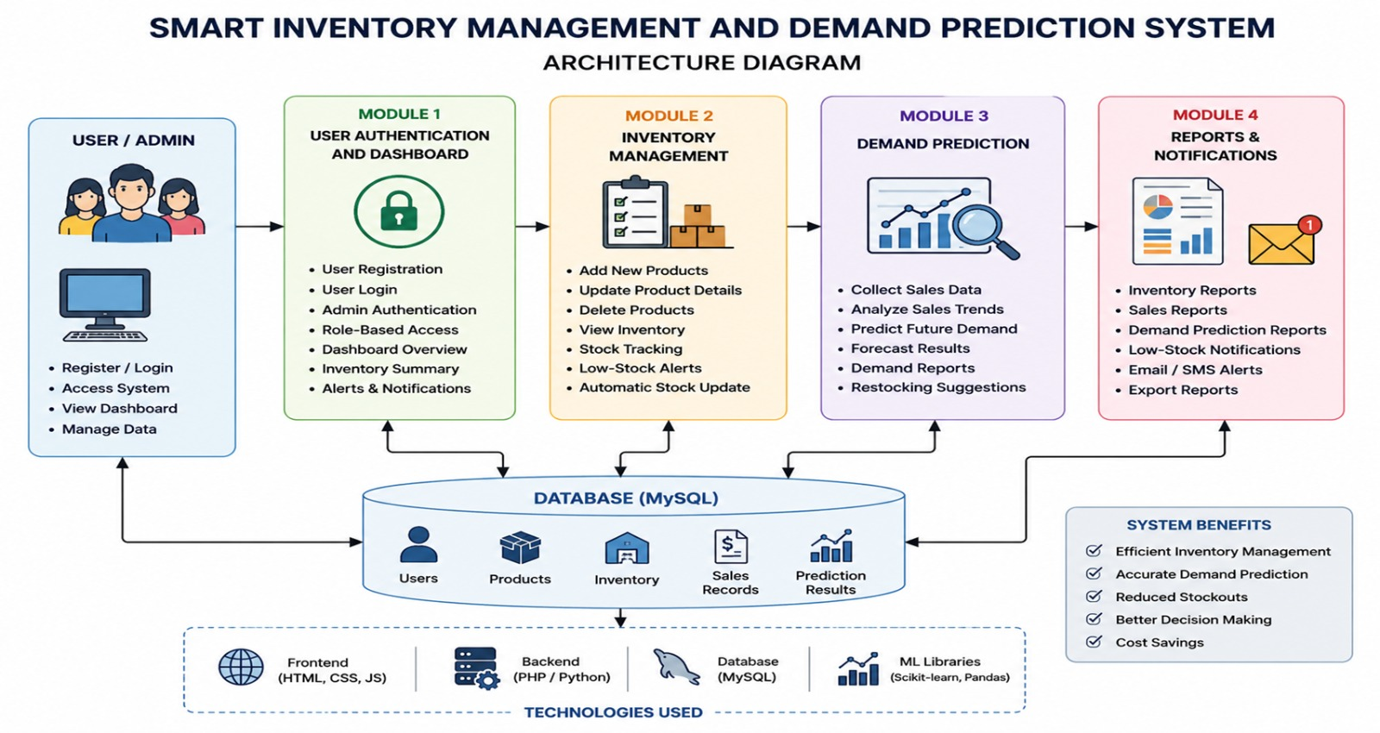
System Architecture / Workflow

Slide 7
List of Modules
Module 1: Inventory Management
Module 2: Demand Prediction Engine
Module 3: Alerts & Reorder Management
Module 4: Analytics & Reporting Dashboard

Slide 8
Module 1: Inventory Management
Purpose:
To provide a centralized system for tracking stock levels, product details, and warehouse locations in real time.
Key Implementation Details:
Add, update, and manage product and stock records
Track inventory across multiple warehouses/stores
Barcode/SKU-based product identification
Real-time stock level synchronization
Techniques Used:
CRUD-based inventory database design
Real-time data synchronization
Role-based access control
Input validation and data integrity checks

Slide 9
Module 2: Demand Prediction Engine
Purpose:
To forecast future product demand using historical sales and seasonal patterns, enabling proactive inventory planning.
Key Implementation Details:
Collect and preprocess historical sales data
Train machine learning models for demand forecasting
Account for seasonality, trends, and promotions
Generate demand forecasts for defined time periods
Techniques Used:
Time-series forecasting (ARIMA/Prophet)
Regression-based ML models
Feature engineering on sales data
Model evaluation and accuracy tuning

Slide 10
Module 3: Alerts & Reorder Management
Purpose:
To automatically notify stakeholders of low stock and recommend optimal reorder quantities based on predicted demand.
Key Implementation Details:
Set minimum stock thresholds per product
Generate automated low-stock alerts
Calculate suggested reorder quantities and timing
Notify managers via dashboard/email notifications
Techniques Used:
Threshold-based alert triggers
Reorder point (ROP) calculation
Notification/email API integration
Rule-based automation logic

Slide 11
Module 4: Analytics & Reporting Dashboard
Purpose:
To visualize inventory status, demand trends, and forecasting insights for informed business decision-making.
Key Implementation Details:
Interactive dashboards for stock and sales trends
Visual demand forecast charts
Exportable reports for management review
Performance metrics like turnover rate and stockout rate
Techniques Used:
Data visualization (charts/graphs)
Backend API integration for real-time data
Report generation and export functionality
Dashboard filtering and drill-down views

Slide 12


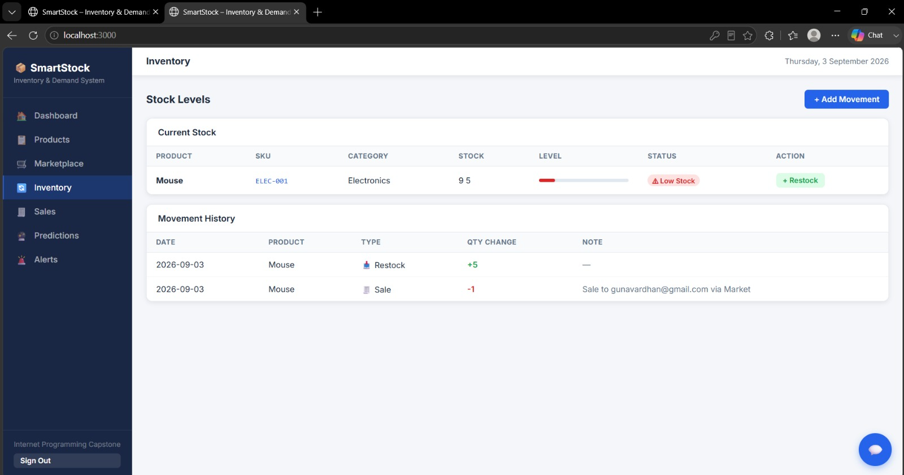
Implementation

Slide 13

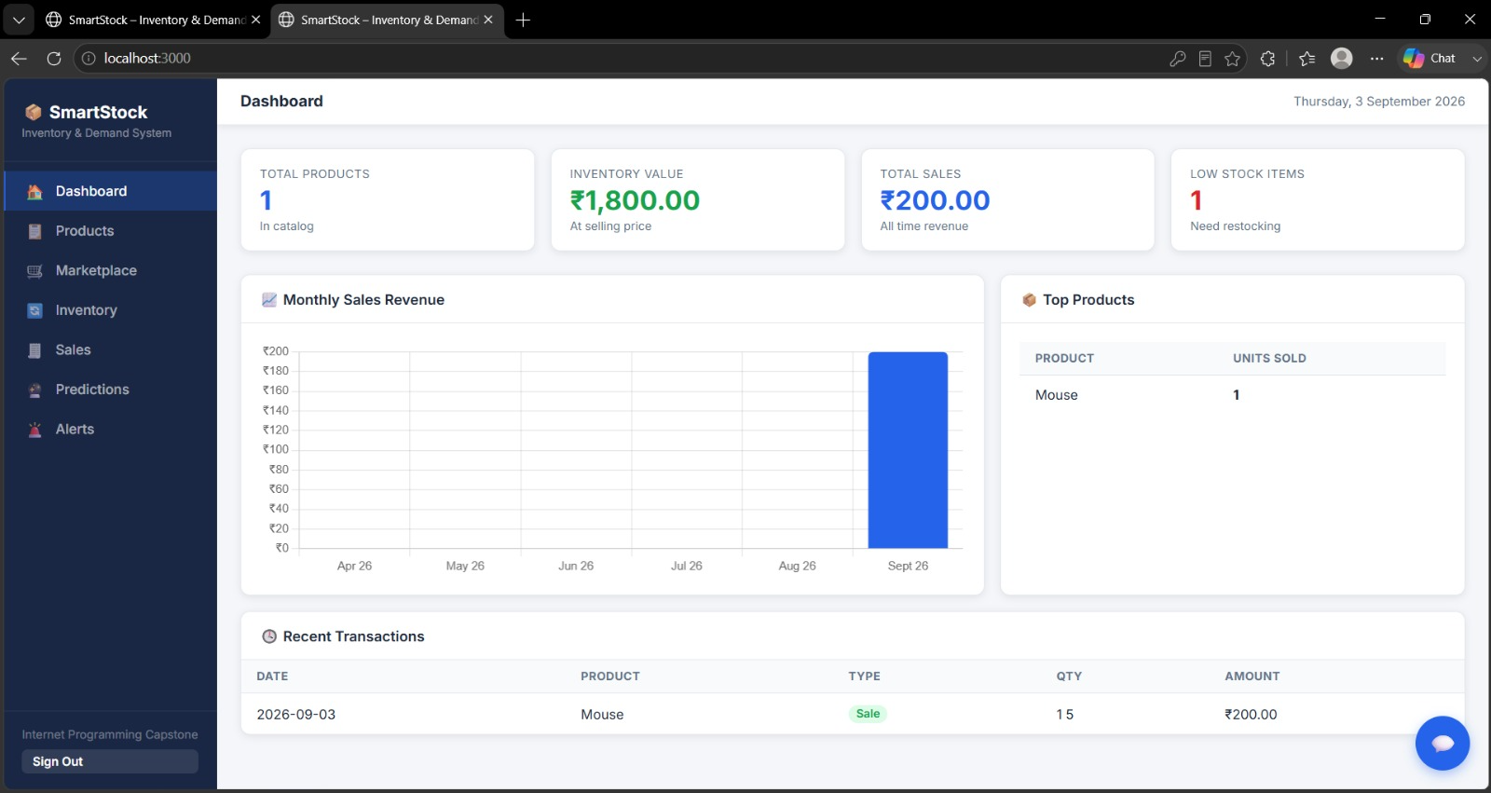

Slide 14
Conclusion
The Smart Inventory Management and Demand Prediction System provides an intelligent, automated approach to inventory control and demand forecasting for modern businesses.
The platform reduces manual effort and human error by automating stock tracking across warehouses and stores.
Through predictive analytics, businesses can significantly reduce stockouts and excess inventory costs.
The alerts and reorder module ensures timely restocking decisions before shortages occur.
The reporting dashboard enables faster, data-driven decision-making across the entire supply chain.

Slide 15
Future scope
Integrate advanced deep learning models (e.g., LSTM) for more accurate long-term demand forecasting.
Expand support for multi-location and multi-supplier inventory networks.
Add AI-driven price optimization based on demand fluctuations and inventory levels.
Enable IoT-based sensors for automated, real-time stock counting.
Improve platform scalability and cloud deployment support to handle enterprise-scale operations.

Slide 16
References
Silver, E.A., Pyke, D.F. & Peterson, R. – Inventory Management and Production Planning and Scheduling (1998)
Hyndman, R.J. & Athanasopoulos, G. – Forecasting: Principles and Practice (2018)
Chopra, S. & Meindl, P. – Supply Chain Management: Strategy, Planning, and Operation (2016)
Makridakis, S., Spiliotis, E. & Assimakopoulos, V. – The M4 Competition: 100,000 time series and 61 forecasting methods (2020)
Waller, M.A. & Fawcett, S.E. – Data Science, Predictive Analytics, and Big Data: A Revolution That Will Transform Supply Chain Design and Management (2013)

Slide 17
Thank You

